Slide 1
Digital Portfolio
STUDENT NAME: V. J. ASHWIN
REGISTER NO AND NMID: 24134031802522010
DEPARTMENT: BSC. COMPUTER SCIENCE -2ND YEARS
COLLEGE: PSPT ARYS AND SCIENCE COLLEGE, PUTTHUR

Slide 2
PROJECT TITLE
MACHINE LEARNING PROJECT

Slide 3


AGENDA
Problem Statement
Project Overview
End Users
Tools and Technologies
Portfolio design and Layout
Features and Functionality
Results and Screenshots
Conclusion
Github Link
3/21/2024 Annual Review

Slide 4

PROBLEM STATEMENT
Clearly define the problem your project aims to solve.
Why is this problem important in the real world?
What are the key challenges.

Slide 5

PROJECT OVERVIEW
A brief description of the projects I worked on: Developed predictive models using supervised learning Applied unsupervised learning for clustering Used deep learning for image recognition tasks Built end-to-end ML pipelines for data preprocessing, training, and evaluation

Slide 6

WHO ARE THE END USERS?
Data Scientists Business Analysts Product Managers Healthcare Professionals Students & Learners interested in AI

Slide 7

TOOLS AND TECHNIQUES
Languages: Python Libraries: scikit-learn, TensorFlow, Keras, Pandas, NumPy, Matplotlib Platforms: Jupyter Notebook, Google Colab Data Sources: Kaggle datasets, UCI Machine Learning Repository

Slide 8
POTFOLIO DESIGN AND LAYOUT
Describe how you structured the project files, notebooks, and folders.
8

Slide 9
FEATURES AND FUNCTIONALITY
Data Cleaning & Preprocessing Model Training & Evaluation (Accuracy, Precision, Recall) Hyperparameter Tuning Visualization of Results (Graphs, Confusion Matrix) Model Saving and Loading for Inference

Slide 10

RESULTS AND SCREENSHOTS
Example Accuracy: 95% on MNIST Digit Classifier Visualizations of loss and accuracy curves during training Sample predictions on new data
3/21/2024 Annual Review
10

Slide 11
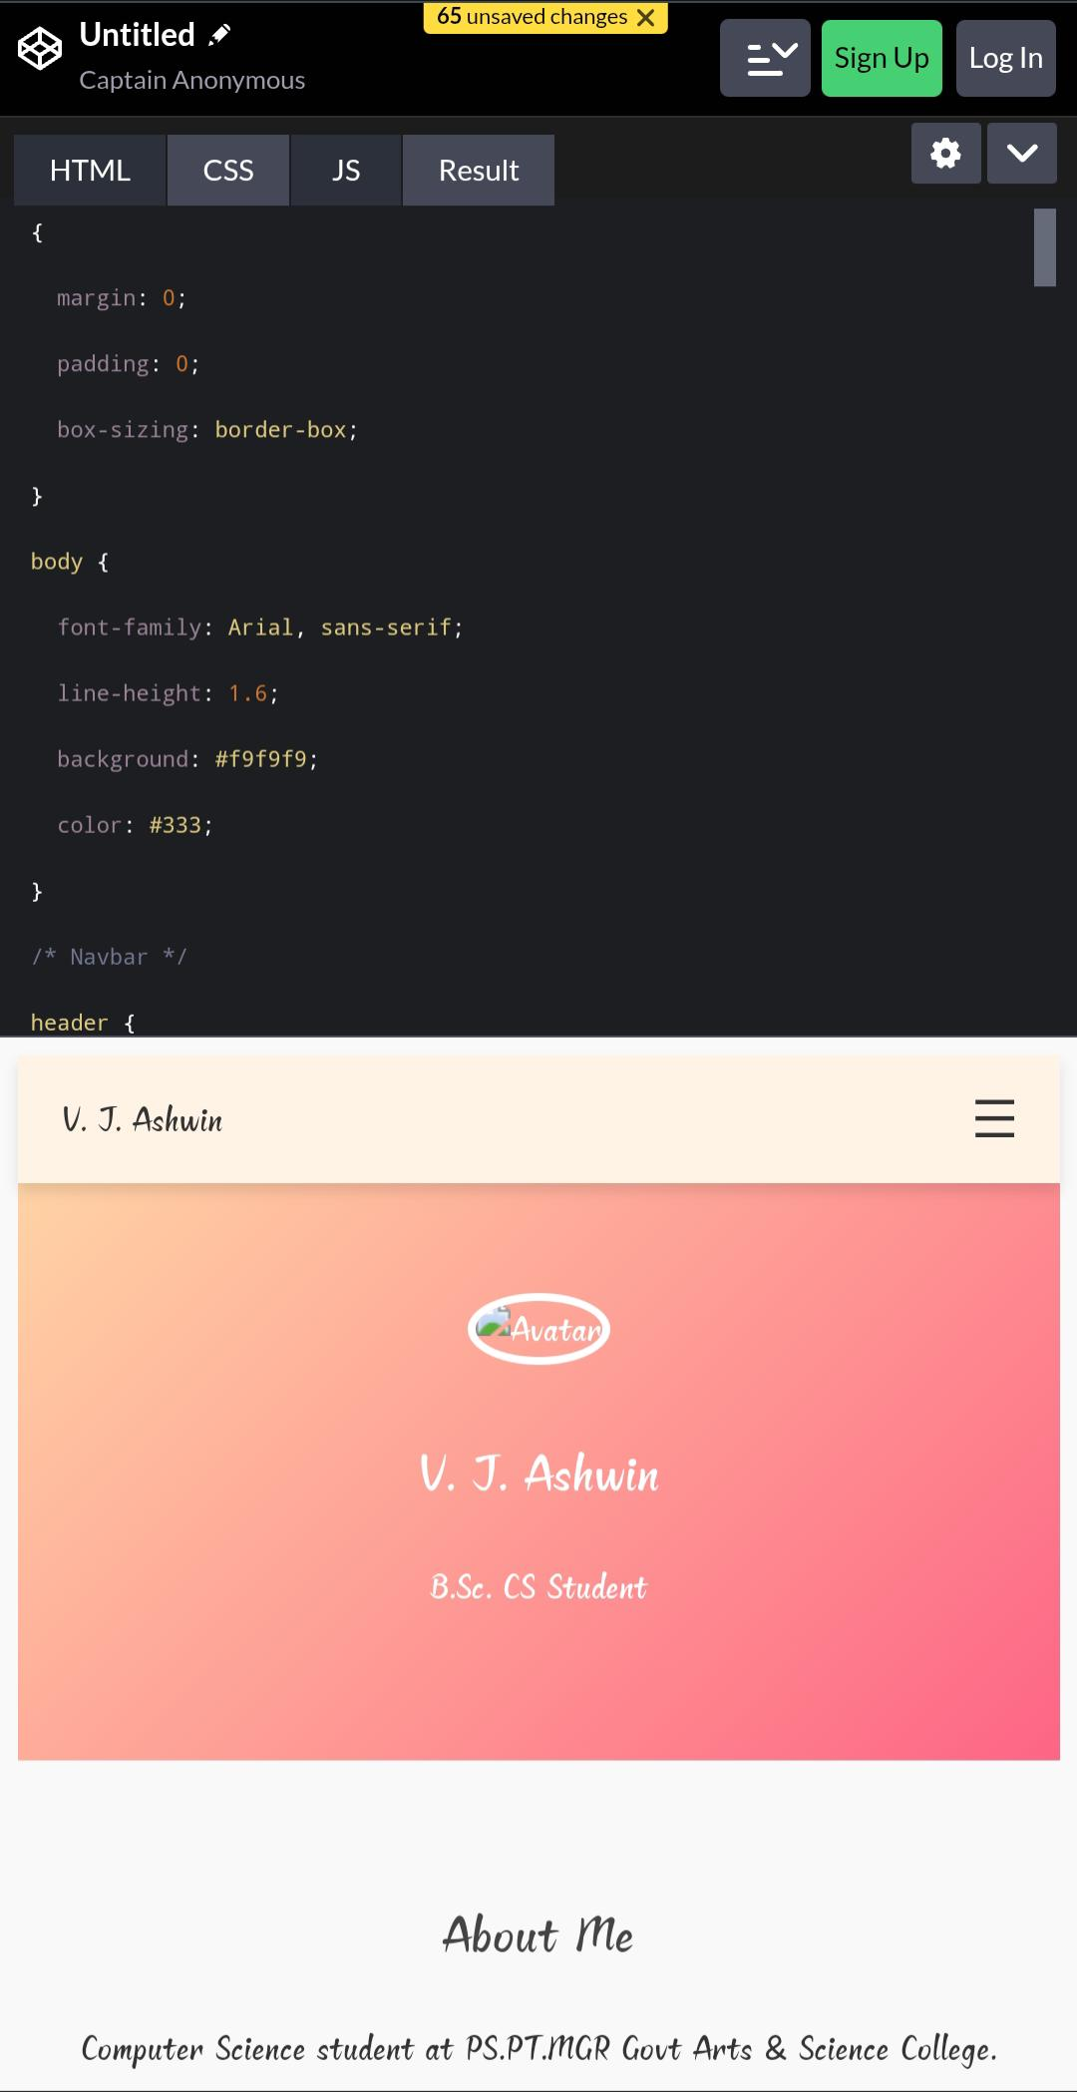
Screenshot

Slide 12
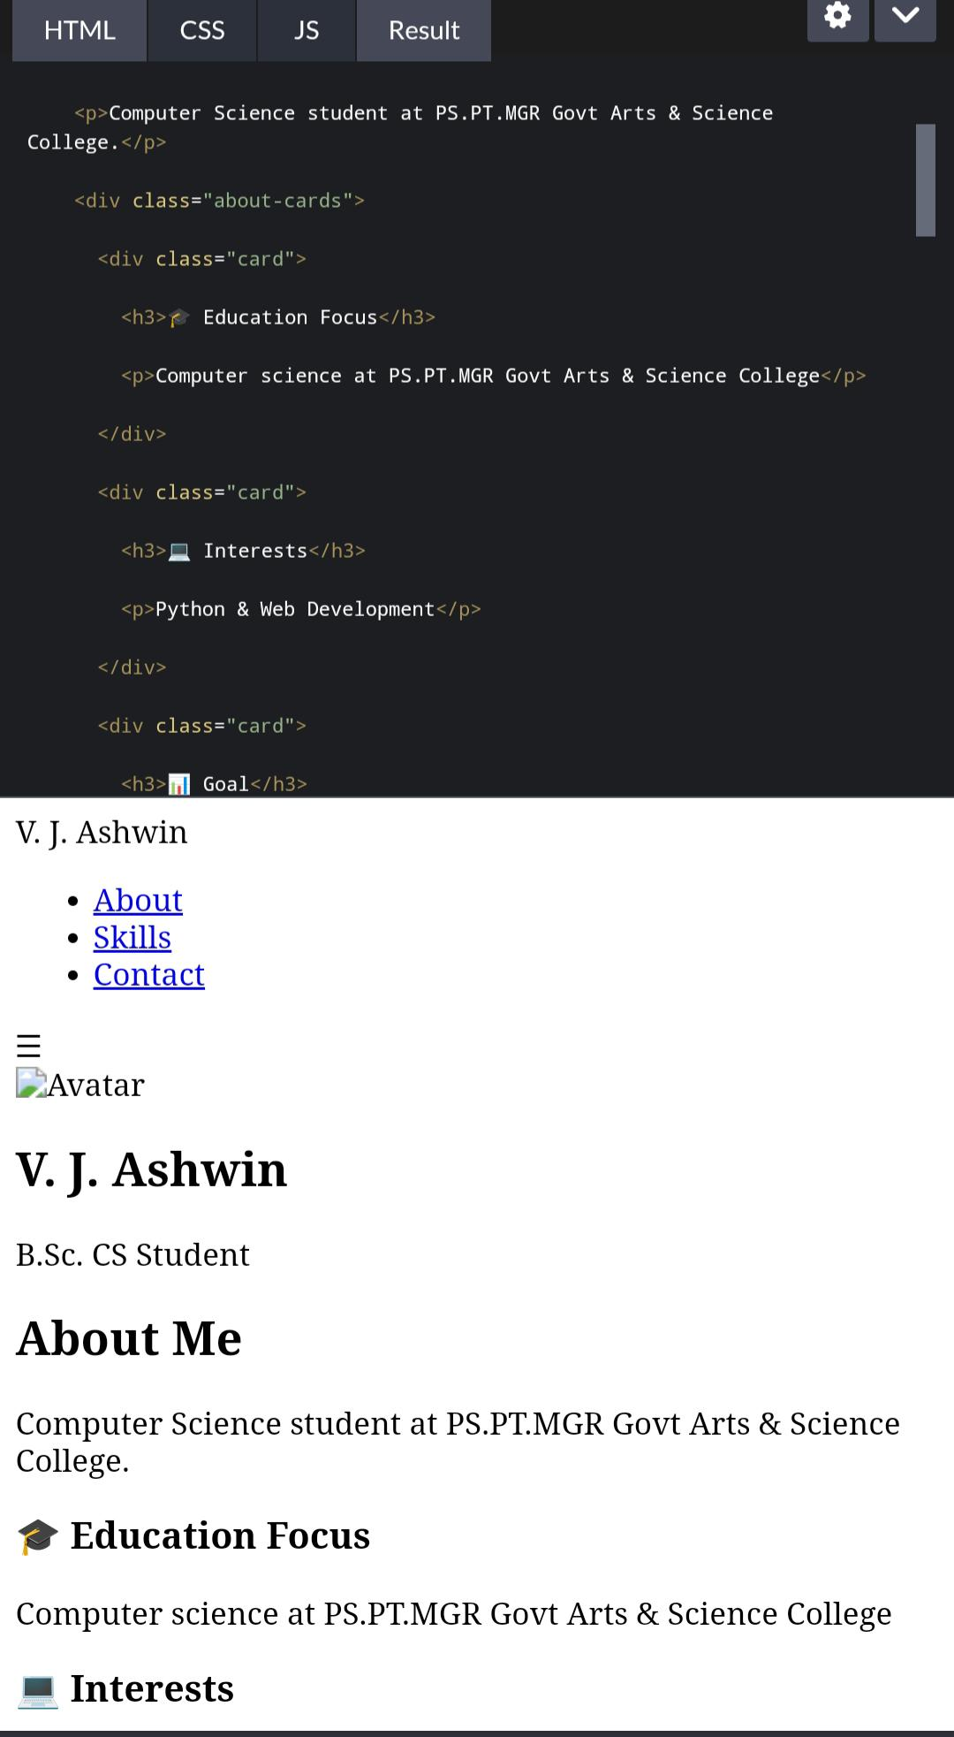

Slide 13
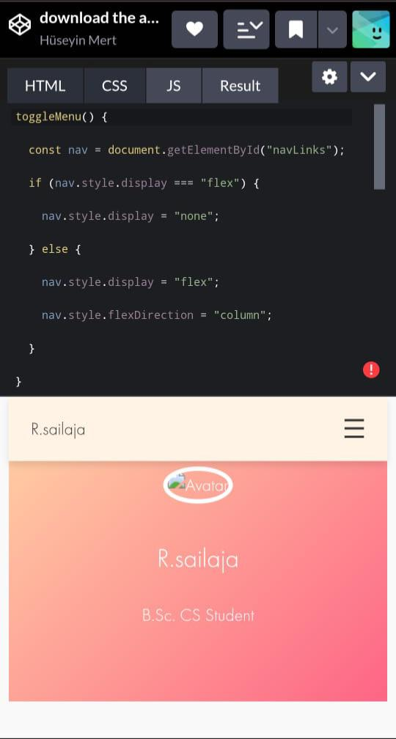

Slide 14
Conclusion
Strong understanding of supervised & unsupervised algorithms ✔️ Ability to work with large datasets ✔️ Experience in data visualization and model evaluation Future Goal: Develop more advanced deep learning models & deploy ML applications.

Slide 15
GitHub link
https://github.com/YourUsername/ML-Projects-Showcase

